Slide 1
CS467 Machine Learning

Slide 2

Machine Learning

Slide 3


Slide 4


Slide 5


Slide 6
Machine Learning
Arthur Samuel, an early American leader in the field of computer gaming and artificial intelligence,coined the term “Machine Learning” in 1959 while at IBM.
He defined machine learning as “the field of study that gives computers the ability to learn without being explicitly programmed.”

Slide 7
Definition of Learning
In 1997, Tom Mitchell gave a “well-posed” mathematical and relational definition”
A computer program is said to learn from experience E with respect to some class of tasks T and performance measure P, if its performance at tasks T, as measured by P, improves with experience E.

Slide 8
Handwriting recognition learning problem
Task T: Recognising and classifying handwritten words within images
Performance P: Percent of words correctly classified
Training experience E: A dataset of handwritten words with given classifications

Slide 9
A robot driving learning problem
Task T: Driving on highways using vision sensors
Performance measure P: Average distance traveled before an error
Training experience E: A sequence of images and steering commands recorded while observing a human driver

Slide 10
A chess learning problem
Task T: Playing chess
Performance measure P: Percent of games won against opponents
Training experience E: Playing practice games against itself
A computer program which learns from experience is called a machine learning program or simply a learning program. Such a program is sometimes also referred to as a learner.

Slide 11
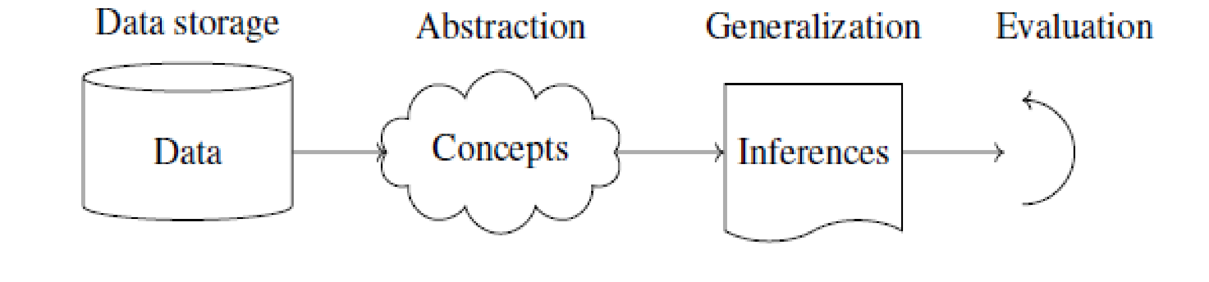
How machines learn
Basic components of learning process
The learning process, whether by a human or a machine, can be divided into four components,namely,
Data storage,
Abstraction,
Generalization,
Evaluation.

Slide 12
Data Storage
Facilities for storing and retrieving huge amounts of data are an important component ofbthe learning process. Humans and computers alike utilize data storage as a foundation for advanced reasoning.
In a human being, the data is stored in the brain and data is retrieved using electrochemical signals.
Computers use hard disk drives, flash memory, random access memory and similar devices to store data and use cables and other technology to retrieve data.

Slide 13
Abstraction
The second component of the learning process is known as abstraction.
Abstraction is the process of extracting knowledge about stored data. This involves creating general concepts about the data as a whole. The creation of knowledge involves application of known models and creation of new models.
The process of fitting a model to a dataset is known as training. When the model has been trained, the data is transformed into an abstract form that summarizes the original information.

Slide 14
Generalization
The third component of the learning process is known as generalisation.
The term generalization describes the process of turning the knowledge about stored data into a form that can be utilized for future action.
The ability of an algorithm to perform accurately on new,unseen examples after having trained on a learning dataset.

Slide 15
Evaluation
Evaluation is the last component of the learning process.
It is the process of giving feedback to the user to measure the utility of the learned knowledge.
This feedback is then utilised to effect improvements in the whole learning process.

Slide 16

Applications of machine learning
Application of machine learning methods to large databases is called data mining.
In data mining, a large volume of data is processed to construct a simple model with valuable use, for example, havinghigh predictive accuracy

Slide 17
Applications of Machine Learning
In retail business, machine learning is used to study consumer behaviour.
2. In finance, banks analyze their past data to build models to use in credit applications, fraud detection, and the stock market.
3. In manufacturing, learning models are used for optimization, control, and troubleshooting.
4. In medicine, learning programs are used for medical diagnosis.

Slide 18
Applications of Machine Learning
6. In science, large amounts of data in physics, astronomy, and biology can only be analyzed fast enough by computers. The World Wide Web is huge; it is constantly growing and searching for relevant information cannot be done manually.
7. In artificial intelligence, it is used to teach a system to learn and adapt to changes so that the system designer need not foresee and provide solutions for all possible situations.
8. It is used to find solutions to many problems in vision, speech recognition, and robotics.

Slide 19
Applications of Machine Learning
9. Machine learning methods are applied in the design of computer-controlled vehicles to steer correctly when driving on a variety of roads.
10. Machine learning methods have been used to develop programmes for playing games such as chess, backgammon and Go.

Slide 20
DATA

Slide 21
Different Types of DATA
Since an important component of the machine learning process is data storage, we briefly consider in this section the different types and forms of data that are encountered in the machine learning process.
Unit of observation
By a unit of observation we mean the smallest entity with measured properties of interest for a study.
Examples
A person, an object or a thing
A time point
A geographic region
A measurement
Sometimes, units of observation are combined to form units such as person-years.

Slide 22
Examples and Features
Datasets that store the units of observation and their properties can be imagined as collections of data consisting of the following:
Examples
An “example” is an instance of the unit of observation for which properties have been recorded.
An “example” is also referred to as an “instance”, or “case” or “record.”

Slide 23
Examples and Features
Features
A “feature” is a recorded property or a characteristic of examples. It is also referred to as “attribute”, or “variable” .

Slide 24
Examples for “examples” and “features”
1.Cancer detection
Consider the problem of developing an algorithm for detecting cancer. In this study we note
the following.
(a) The units of observation are the patients.
(b) The examples are members of a sample of cancer patients.
(c) The following attributes of the patients may be chosen as the features:
gender
age
blood pressure
the findings of the pathology report after a biopsy

Slide 25
Examples for “examples” and “features”
Spam e-mail
Let it be required to build a learning algorithm to identify spam e-mail.
(a) The unit of observation could be an e-mail messages.
(b) The examples would be specific messages.
(c) The features might consist of the words used in the messages.

Slide 26
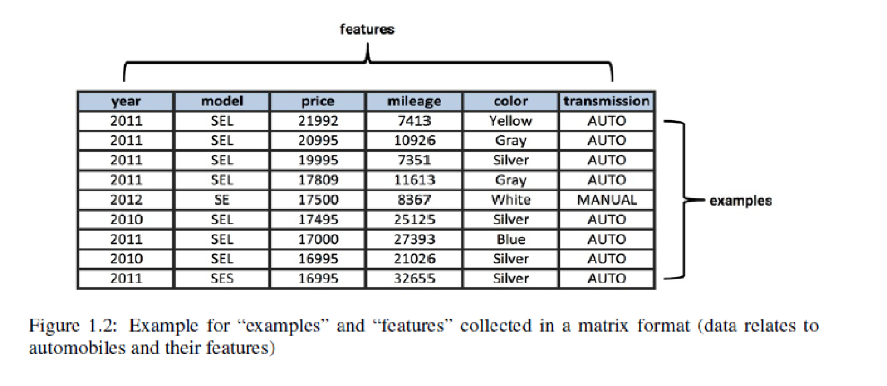
DATA SET
Examples and features are generally collected in a matrix format.

Slide 27
Different forms of data
1. Numeric data
2. Categorical or nominal
3. Ordinal data

Slide 28
Different forms of data
Numeric Data
If a feature represents a characteristic measured in numbers, it is called a numeric feature.
Categorical or norminal Data
A categorical feature is an attribute that can take on one of a limited, and usually fixed, number of possible values on the basis of some qualitative property. A categorical feature is also called a nominal feature.

Slide 29
Different types of Data
Ordinal Data
This denotes a nominal variable with categories falling in an ordered list. Examples include clothing sizes such as small, medium, and large, or a measurement of customer satisfaction on a scale from “not at all happy” to “very happy.”

Slide 30
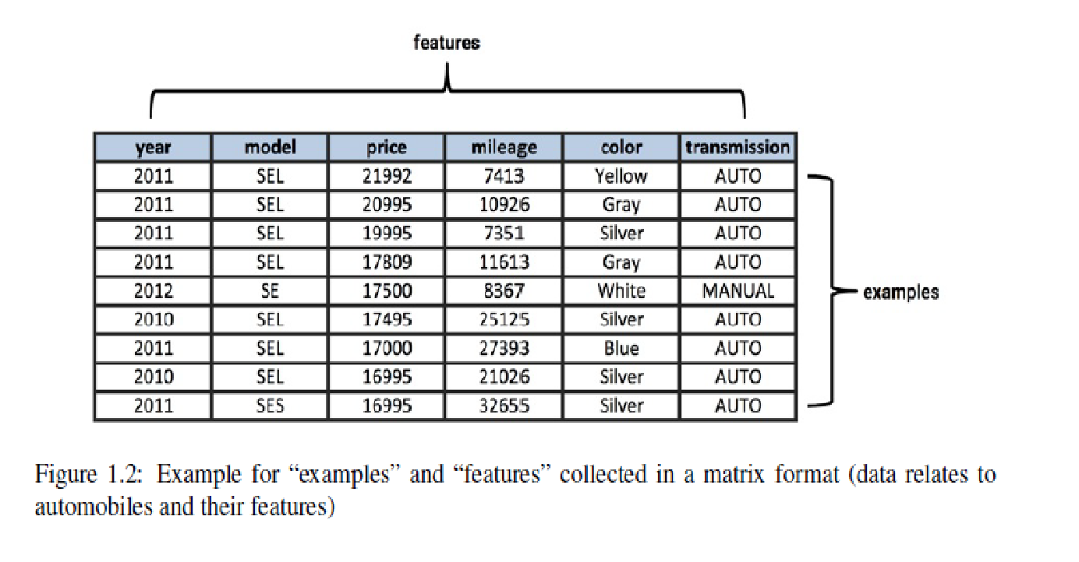
In the data given in Fig.1.2, the features “year”, “price” and “mileage” are numeric and the features “model”, “color” and “transmission” are categorical.

Slide 31
Examples of Machine Learning Applns
1.Learning Associations
Association rule learning is a machine learning method for discovering interesting relations, called “association rules”, between variables in large databases using some measures of “interestingness”.

Slide 32
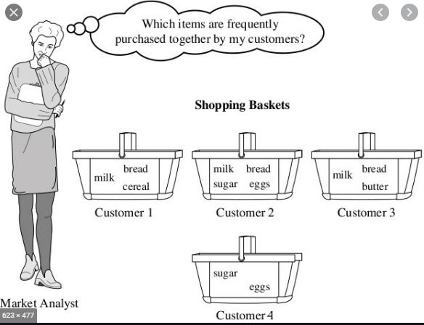
Market Basket Analysis

Slide 33
Example
Consider a supermarket chain. The management of the chain is interested in knowing whether there are any patterns in the purchases of products by customers like the following:
“If a customer buys onions and potatoes together, then he/she is likely to also buy hamburger.”
This defines an association between the set of products {onion, potato} and the set {burger}. This association is represented in the form of a rule as follows:
{onion, potato} {burger}

Slide 34
The measure of how likely a customer, who has bought onion and potato, to buy burger also is given by the conditional probability
P({burger}|{onion, potato});
If this conditional probability is 0.8, then the rule may be stated more precisely as follows:
“80% of customers who buy onion and potato also buy burger.”

Slide 35
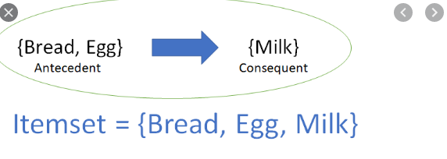
Association Rule
Consider an association rule of the form
X =>Y;
that is, if people buy X then they are also likely to buy Y .
Suppose there is a customer who buys X and does not buy Y . Then that customer is a potentialY customer.
Once we find such customers, we can target them for cross-selling. A knowledge of such rules can be used for promotional pricing or product placements.

Slide 36
Association Rule
In finding an association rule X Y , we are interested in learning a conditional probability of the form P(Y |X) where Y is the product the customer may buy and X is the product or the set of products the customer has already purchased.

Slide 37
Algorithms Used for Learning Associations
There are several algorithms for generating association rules. Some of the well-known algorithms are listed below:
a) Apriori algorithm
c) FP-Growth Algorithm (FP stands for Frequency Pattern)

Slide 38
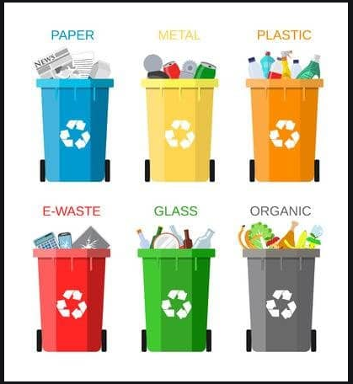
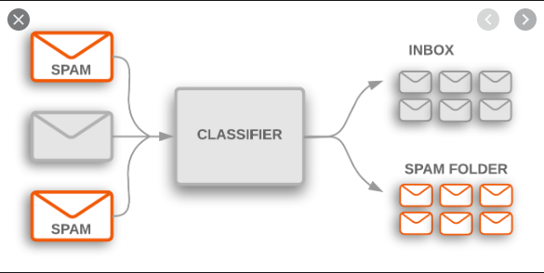
Classification

Slide 39
Classification
In machine learning, classification is the problem of identifying to which of a set of categories a new observation belongs, on the basis of a training set of data containing observations (or instances) whose category membership is known.

Slide 40
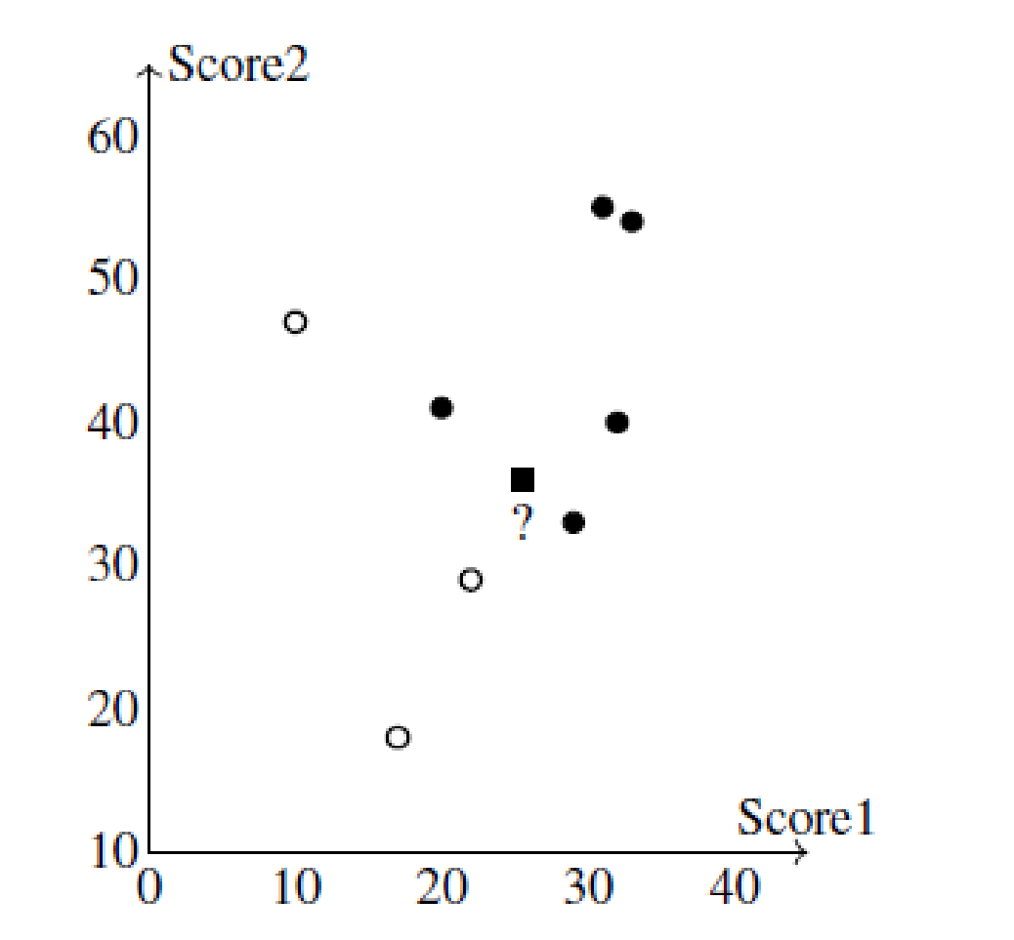
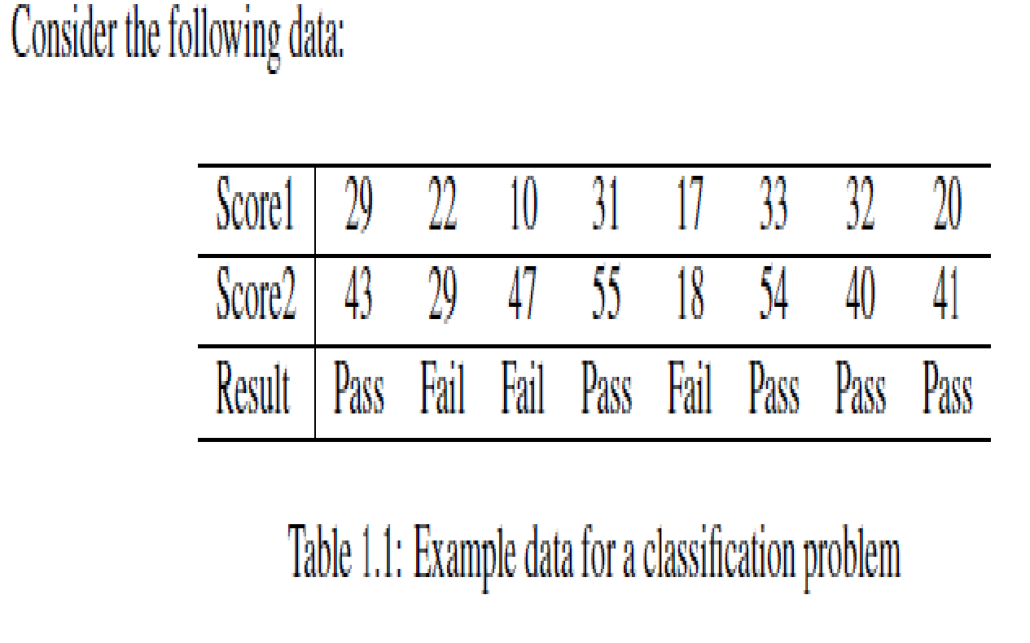
Example

Slide 41
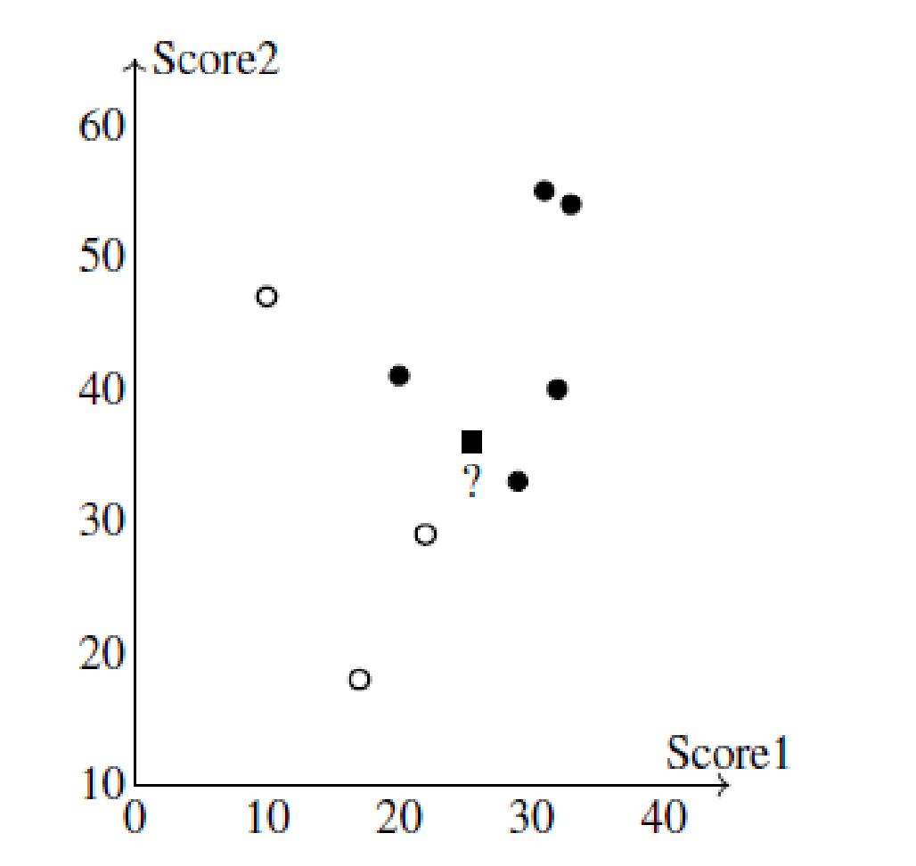
Example
If we have some new data, say “Score1 = 25” and “Score2 = 36”, what value should be assigned to “Result” corresponding to the new data;
to which of the two categories or classes the new observation should be assigned?

Slide 42
To answer this question, using the given data alone we need to find the rule, or the formula, or the method that has been used in assigning the values to the class label “Result”.
The problem of finding this rule or formula or the method is the classification problem.

Slide 43
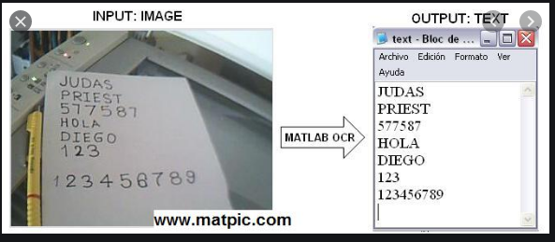
Real life examples
Optical Character Recognition.
Optical character recognition problem, which is the problem of recognizing character codes from their images, is an example of classification problem.

Slide 44
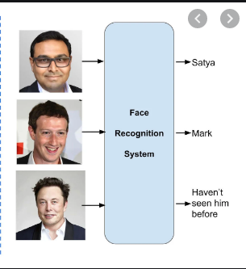
Face Recognition
In the case of face recognition, the input is an image, the classes are people to be recognized,and the learning program should learn to associate the face images to identities.

Slide 45

Speech recognition
In speech recognition, the input is acoustic and the classes are words that can be uttered.

Slide 46
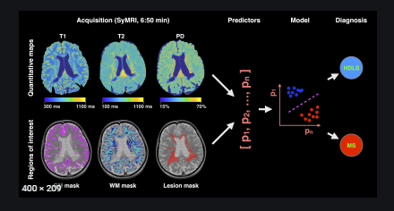
Medical diagnosis
In medical diagnosis, the inputs are the relevant information we have about the patient and the classes are the illnesses.

Slide 47
Discriminant
A discriminant of a classification problem is a rule or a function that is used to assign labels to new observations.
Consider a finance company which lends money to customers. Before lending money, the company would like to assess the risk associated with the loan. For simplicity, let us assume that the company assesses the risk based on two variables, namely, the annual income and the annual savings of the customers.
Let x1 be the annual income and x2 be the annual savings of a customer.. After using the past data, a rule of the following form with suitable values for 1 and 2 may be formulated:
IF x1 > 1 AND x2 > 2 THEN “low-risk” ELSE “high-risk”.

Slide 48
Examples of machine learning algorithms for classification.
a)Logistic regression
b) Naive Bayes algorithm
c) k-NN algorithm
d) Decision tree algorithm
e) Support vector machine algorithm
f) Random forest algorithm

Slide 49
Classification
A classification problem requires that examples be classified into one of two or more classes.
A classification can have real-valued or discrete input variables.
A problem with two classes is often called a two-class or binary classification problem.
A problem with more than two classes is often called a multi-class classification problem.
A problem where an example is assigned multiple classes is called a multi-label classification problem.

